Slide 1
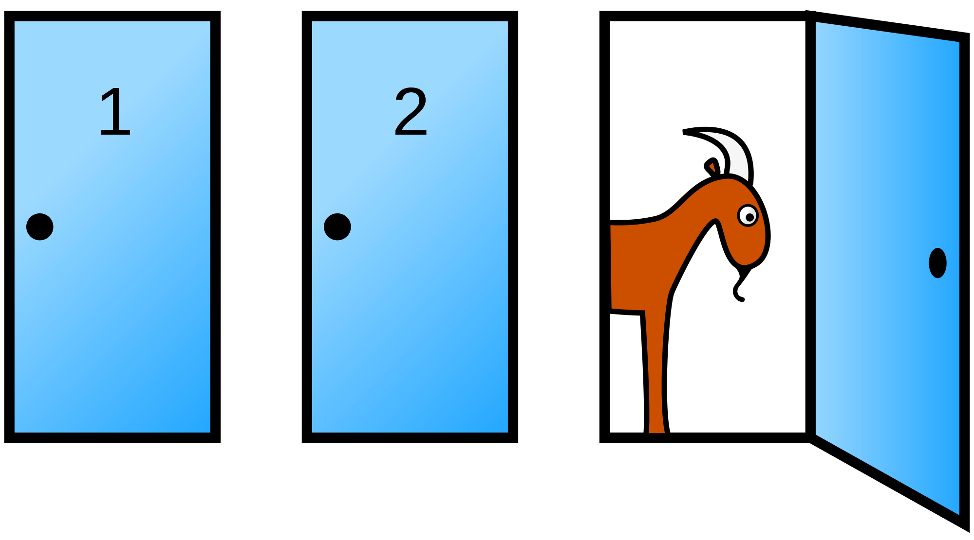
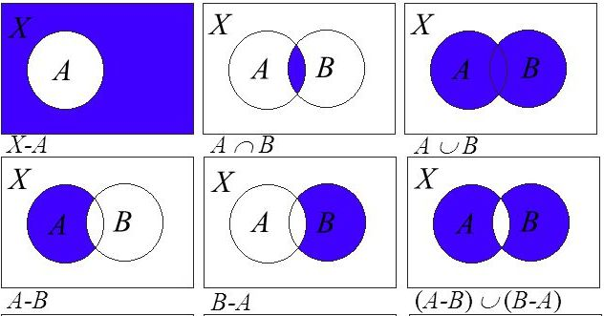
Conditional Probability
U
B
A
x
C
Monty Hall Problem
Experiment
Sample Space
Chapter 3 Part 4
Event
Sure
Impossible
Simple
Compound
Probability
Notes:
The two examples provided at the beginning of this session are accessible from questions on website:
https://www.mathsisfun.com/data/probability.html

Slide 2
Conditional Probability
Case of Two Events A and B happening in succession, given that event B has occurred, the conditional probability of happening A is denoted by
Read as: Probability of A
Given that
B has already occurred
OR: Probability of A
If B happened already
and is computed by
where
Notes:
We learned about probability, its nothing but frequency of occurrence, you have to count the number of elements of sample space and events to compute it.
There are events when happen in succession, they affect each other, they increase or decrease chance or probability of the second event. For example, driving under the influence, it increases chance of accidents. Now, to consider this tangled effect into account we have this rule to compute probability of the second event when we know the first even has happened.

Slide 3
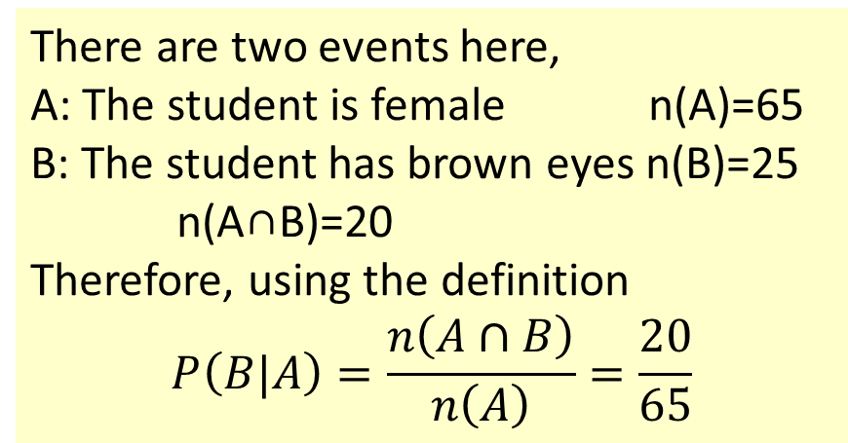
Example
If the student is female, what is the probability that she has brown eyes?
There are two events here,
A: The student is female n(A)=65
B: The student has brown eyes n(B)=25
n(A∩B)=20
Therefore, using the definition
$$P\left(B|A\right)=\frac{n\left(A∩B\right)}{n\left(A\right)}=\frac{20}{65}$$
A sample of 150 students are categorized based on their gender and eye color. We select a student at random.
Gender
 | Female | Male | Total
Brown | 20 | 5 | 25
Blue | 15 | 30 | 45
Green | 30 | 50 | 80
Total | 65 | 85 | 150
Eye Color
You can usually answer conditional probability questions by reducing the sample space based on what is already known (65), then counting the plausible units in the event (20), finally using basic definition of probability 20/65
Notes:
Remember frequency table, or t table, we had one variable with different levels or values and a column of frequencies representing counts in each value.
The following table shows the cross table of this sample data

Slide 4
Question
a) If the student has brown eyes, what is the probability that the student is female?
A sample of 150 students are categorized based on their gender and eye color. We select a student at random.
b) What is the probability that the student is male given that he has green eyes?
Gender
 | Female | Male | Total
Brown | 20 | 5 | 25
Blue | 15 | 30 | 45
Green | 30 | 50 | 80
Total | 65 | 85 | 150
Eye Color
c) What is the probability that the student is a female with blue eyes?
Notes:
a) 20/25 b) 50/80 c) 15/150

Slide 5
Example
you never get an answer greater than 1 in probability questions
In drawing a single card from an ordinary deck of 52 cards. What is the probability that
a) the card is a picture card, given that the card is a spade.
Defining events: A: a picture card B: a spade card
b) Given that the card is a heart, its number is less than or equal to 2
Defining events: E: number less than equal 2
F: a heart card
c) The card is spade if we know it’s a king
Notes:
a) P(A|B)=3/13
b) P(E|F)=2/13 Lets say ace counts as number 1
c) 1/4 I fixed an issue in the videos, changed ace to spade
P(The card is ace if we know it’s a king) = 0

Slide 6
Question
 | Smoke?
. | Yes | No
Male | 19 | 41
Female | 12 | 28
The question, "Do you smoke?" was asked of 100 people. Results are shown in the table. What is the probability that a randomly selected individual
a) is a male AND a smoker?
A: Male
B: Smoker
b) is a male given that is smoker?
c) Given that is a female is a smoker?
A: Male
A’: Female
you never get an answer greater than 1 in probability questions
d) Given that is a smoker is a female?
Notes:
a) P(A∩B)= n(A∩B)/n(S)= 19/100
b) P(A|B)= n(A∩B)/n(B)= 19/31
c) P(B|A’)= n(B∩A’)/n(A’)= 12/40
d) P(A’|B)= n(A’∩B)/n(B)= 12/

Slide 7



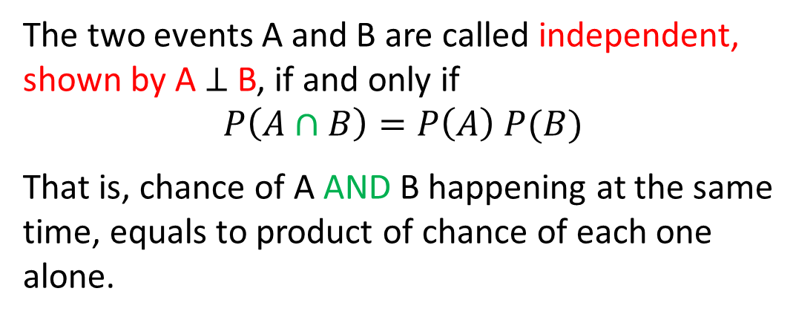

Independent Events
Example. Independent
Two cards are selected from a standard deck of 52 cards with replacement. What is the probability that two Heart cards are selected
The two events A and B are called independent, shown by A $⊥$ B, if and only if
$$P\left(A∩B\right)=P\left(A\right) P(B)$$
That is, chance of A AND B happening at the same time, equals to product of chance of each one alone.
$$\frac{13}{52}×\frac{13}{52}$$
$$P\left(H∩H\right)=$$
Example. Dependent
Two cards are selected from a standard deck of 52 cards without replacement, what is the probability that two Heart cards are selected
If two events A and B are dependent, then their AND probability is computed by one of the following formulas
if A happens first
$$P\left(H∩H\right)=$$
$$\frac{13}{52}×\frac{12}{51}$$
if B happens first
Notes:
When two events don’t interfere with each others’ probability, they are said to be independent. Otherwise, they are dependent which in that case their AND probability is computed using one the two definitions, depending on which event happens first.
One thing to remember is that sampling without replacement imposes dependence upon experiments.

Slide 8
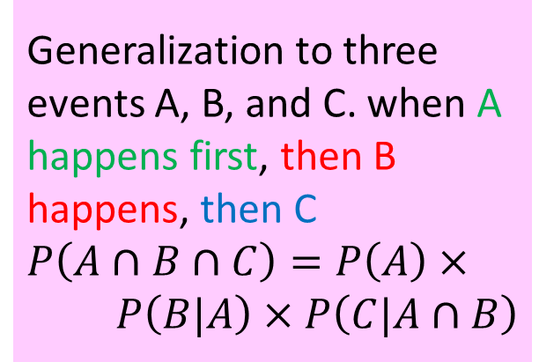
Example
Generalization to three events A, B, and C. when A happens first, then B happens, then C
$$P\left(A∩B∩C\right)=P\left(A\right)×$$
$$P\left(B|A\right)×P\left(C|A∩B\right)$$
A student has to pass two statistics courses to graduate ST1 and ST2, passing ST1 is required to take ST2.
Suppose probability of students passing ST1 is 0.77. Given that a students has passed ST1, probability of passing ST2 is 0.90.
What is the probability of passing both ST1 and STA2.
P(pass ST1) = 0.77
Pass
0.9
P(pass ST2 | passed ST1) = 0.90
Pass
0.77
0.1
P(pass ST1 ∩ ST2)
Fail
0.23
= P(pass ST1) * P(pass ST2 | passed ST1)
= 0.77 * 0.90 = 0.693
Fail
Notes:
Tree diagram helps GREATLY with answering these conditional probabilities

Slide 9

Example
2 blue and 3 red marbles are in a bag. We draw three marbles at random. What are the chances of getting a blue, blue and red marble in that order?
A: having a blue marble on the first draw
B: having a blue marble on the second draw
1st
2nd
3rd
C: having a red marble on the third draw
P(A∩B∩C) = P(A) P(B|A) P(C|A∩B)
=
Notes:
Since the selection is without replacement we have to use the conditional probability rule for three events. Computing this probability is easy by following the number and color and marbles through the experiment and applying simple probability definition.
Answer: (2/5)*(1/4)*(3/3)
If it was with replacement: (2/5)*(2/5)*(3/5)= P(A)*P(B)*P(C)

Slide 10
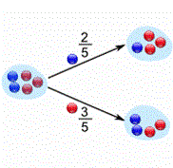
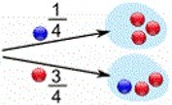
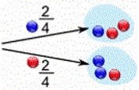





Example
Define
Bi: having a blue marble on i-th extraction,
Ri: having a red marble on i-th extraction
2 blue and 3 red marbles are in a bag. We draw two marbles at random without replacement.
a) Create a tree diagram for possible outcomes of this experiment
$$S=\left\{B_{1}B_{2},B_{1}R_{2},R_{1}B_{2},R_{1}R_{2}\right\}$$
$$P\left(B_{1}R_{2}\right)=$$
$$P\left(R_{2}\right)=$$
$$P\left(R_{1}|R_{2}\right)=$$
$$P\left(R_{1}∩R_{2}\right)/P(R_{2})=$$
b) What is the prob of having a blue then red marble? Show that on the tree diagram.
c) What is the probability of having a red marble on the second draw?
d) If the second marble is red, what is the prob that the first draw is red?
Notes:
Try to find the answer first by following number and color of patterns through the experiment, then by using the chain event probability rule.
b) P(B1∩R2)=P(B1) P(R2 |B1)=(2/5)*(3/4)=0.3
c) P(R2)=P(B1∩R2)+P(R1∩R2)=0.3+P(R1) P(R2 |R1)=0.3+(3/5)*(2/4)=0.3+0.3=0.6
d) P(R1 |R2)=P(R1∩R2)/P(R2)=0.3/0.6=1/2

Slide 11
Bayes Theorem
S
A
Suppose we have a partition B1, B2, …, Bk of the sample space S and A is any arbitrary event.
B1
B2
B3
…
BK
We can compute probability of A by summing up what A has in common with each of the Bi’s, that is
This formula is known as
The Law of Total Probability
and P(B1), P(B2), …, P(Bk) are
Prior Probabilities
Upon observing event A we can update prior probabilities to the following using conditional probability rule:
This is the Bayes Theorem and P(B1|A), P(B2|A), …, P(Bk|A)
are Posterior Probabilities
Notes:
Bayes theorem is one of the most important theorems of not just probability theory, but scientific theorems. It is the very basis of how brain functions and humans, and animals, update their knowledge based on new information.
The main idea is to update a prior belief after an experiment using new information
For example, your joy from eating a certain kind of food, it comes from different sources like taste, aroma, texture, look, etc. These are your prior partitions. For any food that you haven’t tried yet, you have some prior belief on these categories which overall gives you a degree to which you like that food. Once you actually try the food, your price belief is updated based on the new inputs. This is true for meeting new people as well and as you live and gain experience, you’re constantly updating your beliefs based on newer inputs.

Slide 12
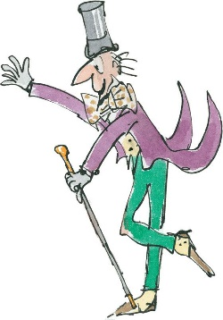
Example
Strawberry
30%
Chocolate
55%
A company produces three flavors of ice cream by the given portions (out of its total production):
Vanilla
15%
There is a 10$ gift card in 3% of the Chocolate ice creams, in 2% of the Strawberries, and 1% in the Vanillas.
a) If I buy an ice cream at random, what is my chance of winning a reward card?
b) If I win, what are the chances that I had picked a Chocolate ice cream?

Slide 13










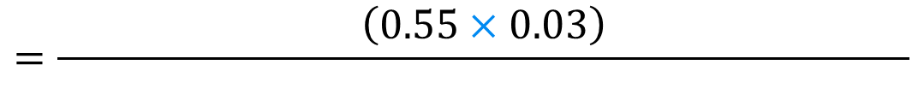


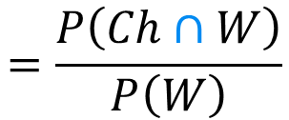

Answer
P(Ch)=0.55 P(St)=0.30 P(Va)=0.15
P(W | Ch) = 0.03
P(W | Str) = 0.02
P(W | Va) = 0.01
$$P\left(W\right)$$
$$=P\left(Ch∩W\right)$$
$$+P\left(St∩W\right)$$
$$+P\left(Va∩W\right)$$
$$=P\left(Ch\right) P\left(W|Ch\right)$$
$$+P\left(St\right) P\left(W|St\right)$$
$$+P\left(Va\right) P(W|Va)$$
$$=\left(0.55×0.03\right)$$
$$+\left(0.30×0.02\right)$$
$$+\left(0.15×0.01\right)$$
$$=0.024$$
$$=\frac{P\left(Ch∩W\right)}{P\left(W\right)}$$
$$P\left(Ch|W\right)$$
$$=\frac{\left(0.55×0.03\right)}{ }$$
$$=0.6875$$
$$\left(0.55×0.03\right)+\left(0.30×0.02\right)+\left(0.15×0.01\right)$$
Notes:
Technically, I could purchase a Chocolate ice-cream AND win OR purchase a Strawberry ice-cream AND win OR purchase a Vanilla ice-cream AND win. That is,
W = (Ch∩Win) U (St∩Win) U (Va∩Win)
Taking probability from the sides, we are using the law of total probability
The next part is updating chance of picking a Chocolate ice-cream knowing that we have won

Slide 14
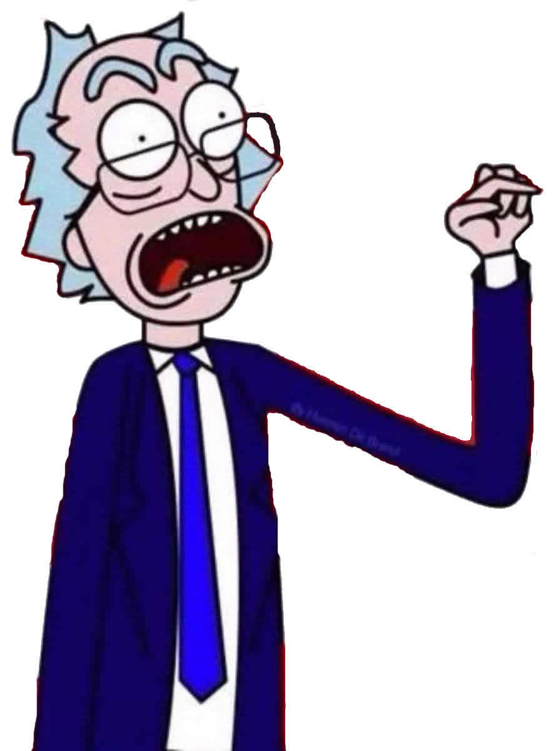
Example
In a certain city, 30% of the people are conservatives, 50% are liberals, and 20% are independents.
Records show that in a particular election, 65% of the conservatives voted, 82% of the liberals voted, and 50% of the independents voted.
a) If a person in the city is selected at random, what are the chances that he/she have voted?
b) If a person in the city is selected at random and it is learned that he/she did not vote in the last election, what is the probability that he/she is Liberal?
Notes:
Graph a tree diagram, then compute the probability using it. The answer will be
a) P(Voted)= (0.3*0.65)+(0.5*0.82)+(0.2*0.50)= 0.705
b) P(Not Voted)= (0.3*0.35)+(0.5*0.18)+(0.2*0.5)= 0.295
P(Liberal | Not Voted)=(0.5*0.18)/0.295= 0.38

Slide 15
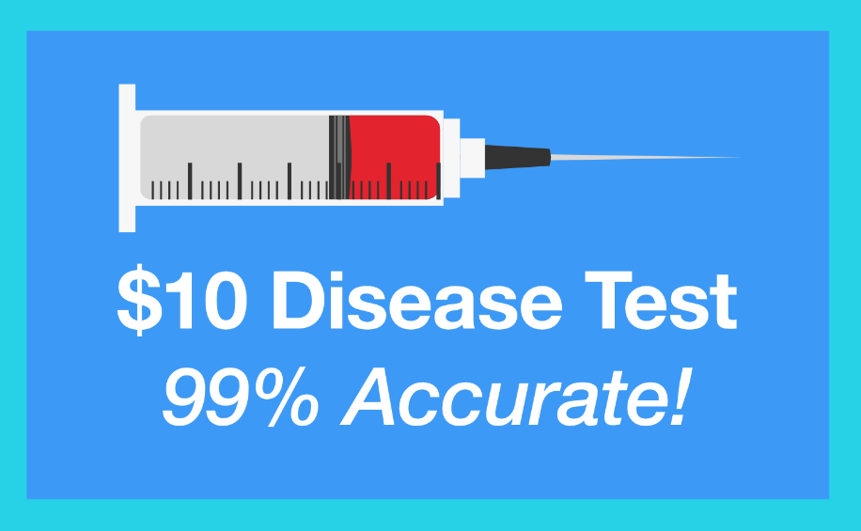
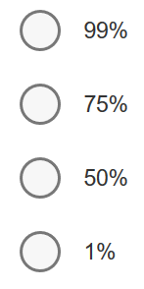
Question
A disease test is advertised as being 99% accurate: if you have the disease, you will test positive 99% of the time, and if you don't have the disease, you will test negative 99% of the time.
If 1% of all people have this disease and you test positive, what is the probability that you actually have the disease?

Slide 16
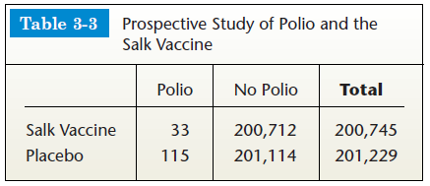

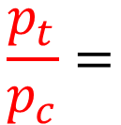

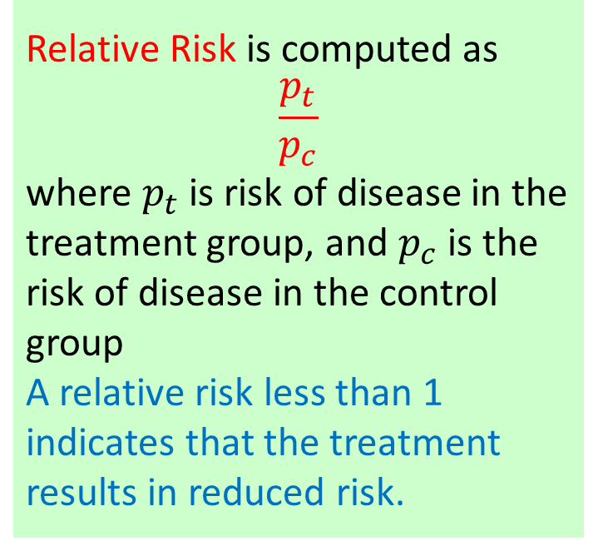





Relative Risk
Based on the given table, what is the chance (Risk) of developing Polio in the group where people have received Salk Vaccine?
What about the Risk of Polio in control group?
Relative Risk is computed as
$$\frac{p_{t}}{p_{c}}$$
where $p_{t}$ is risk of disease in the treatment group, and $p_{c}$ is the risk of disease in the control group
A relative risk less than 1 indicates that the treatment results in reduced risk.
$$p_{t}$$
$$P\left(polio|Salk vaccine\right)=$$
$$\frac{33}{33+200712}=0.000164$$
$$p_{c}$$
$$P\left(polio|Placebo\right)=$$
$$\frac{115}{115+201114}=0.000571$$
Relative Risk =
$$\frac{p_{t}}{p_{c}}=$$
$$0.287$$
of Polio
Notes:
Risk is simply a conditional probability
Risk of Polio in the treatment group = 0.000164
Risk of Polio in the control group = 0.000571
Polio is 0.287 times less likely to occur in children who received the Salk vaccine than children who received placebo. It seems that the vaccine has some positive effect on preventing polio

Slide 17
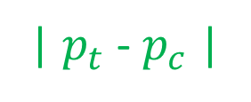
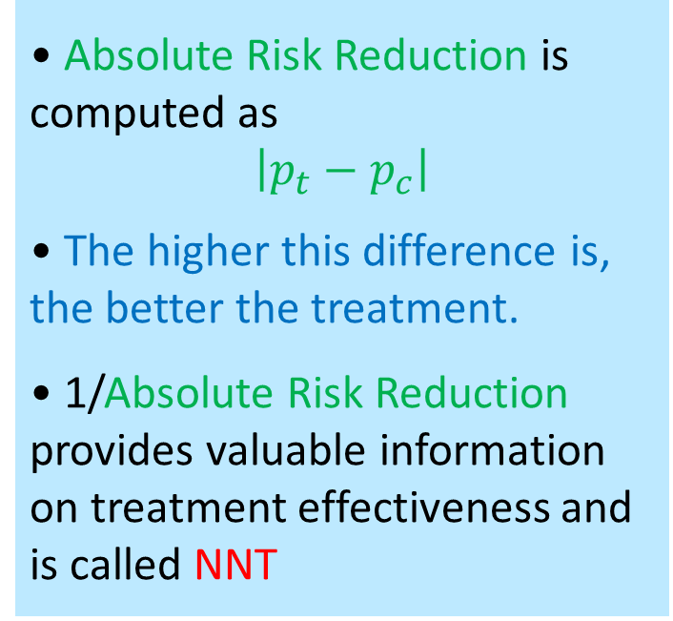
Absolute Risk Reduction
Another measure that helps us decide if a treatment is working is Absolute Risk Reduction:
Absolute Risk
Reduction =
• Absolute Risk Reduction is computed as
$$\left|p_{t}−p_{c}\right|$$
• The higher this difference is, the better the treatment.
• 1/Absolute Risk Reduction provides valuable information on treatment effectiveness and is called NNT
| $p_{t}$- $p_{c}$|
=|0.000164-0.000571|
= 0.000407
Number Needed to Treat =
1 / ARR = 1 / 0.000407
= 2457.002
We will need to vaccinate 2458 children with Salk vaccine to prevent one child from getting polio
Notes:
Here the treatment is not as good as it should be since the Absolute Risk Reduction value is very small and 1/Absolute Risk Reduction is a big number
The ideal NNT would be 1, meaning that all patients who are receiving the studied treatment show an improvement, while none of the patients receiving the control treatment shows an improvement. The higher the NNT, the less effective the treatment. Usually a NNT between 20 and 50 is considered as a good score.

Slide 18
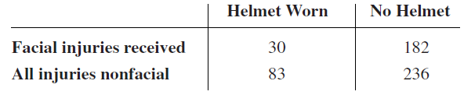
Question
Study of the Effectiveness of Bicycle Safety Helmets in Preventing Facial Injury. Compute Relative Risk of Receiving Facial Injuries, Absolute Risk Reduction, and NNT, then interpret the results.
Notes:
1. Identify the Control and Treatment group (final interpretation is the same if you exchange C and T group)
2. Within Control group ONLY, compute a conditional probability known as Risk
3. Within Treatment group ONLY, compute a conditional probability known as Risk
4. Divide Risk in Treatment group by Risk in Control group to compute Relative Risk, then interpret it
5. Compute ARR and interpret it
6. Compute NNT and interpret it

Slide 19
Practice Problems Part 4
1. Eric reaches his pocket and finds out that there are 10 M&Ms left in his pocket from last year’s Halloween! Suppose we know that there are 3 Red, 5 Green, and 2 Browns M&Ms.
He picks one at random and crunch it with great pleasure. Then, takes another one and toss it into his mouth while remembering the events of last year.
a) Find the probability of having a red and a green M&M in that order.
b) Find the probability of having a red and a green M&M when order doesn’t matter.
c) If the second M&M was green, what are the chances of picking a red M&M first?
2. Consider teens between 13 and 18 years old. Suppose that the probability that a teen is obese is 0.11, the probability that a teen smokes is 0.35, and that the probability that a teen is obese and smokes is 0.03.
a) What is the probability that a teen doesn't smoke given that he/she is obese?
b) Are the two events “obese” and “smoke” independent?
Notes:
Answers are provided in Ch3 Practice Problem Solutions

Slide 20
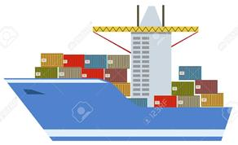

Practice Problems Part 4
.c | Yes | No
Male | 19 | 41
Female | 12 | 28
3. The question, "Do you smoke?" was asked of 100 people.
Results are shown in the table. What is the probability that a randomly selected individual
a) be a male and a smoker? b) be a male given that is smoker?
c) Given that is a female is a smoker? d) Given that is a smoker is a female?
4. A production manager for a pharmaceutical company receives shipments of a particular chemical from two different companies. We know that 40% of the shipments come from Company A and 60% from Company B.
3% of chemical received from Company A are defective while 4.5% of chemical received from Company B are defective.
a) Graph a tree diagram and compute the probability that a randomly selected shipment is from Company B and it is not defective.
b) Compute the probability that a randomly selected shipment is defective.
c) If the shipment is defective, what are the chances that it comes from Company A?
Notes:
Answers are provided in Ch3 Practice Problem Solutions.

Slide 21
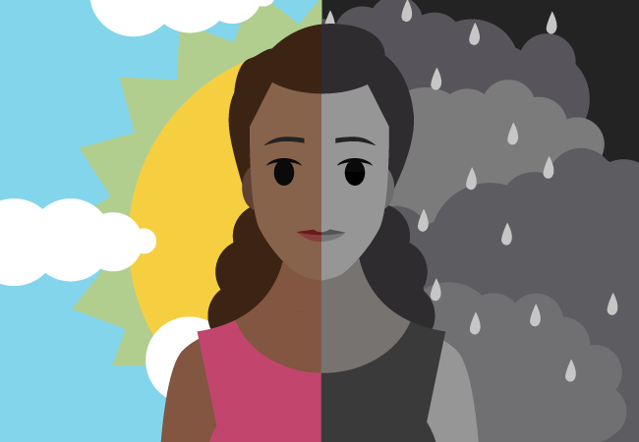
Practice Problems Part 4
5. For a particular population the medical literature suggests that 15% of individuals have a family history of mood disorder. Among the individuals with a family history of mood disorder, 34% develop bipolar disorder at a young age. Among the individuals without a family history of mood disorder, 78% do not develop bipolar disorder at a young age.
a) What is the probability that a randomly selected individual has a family history of mood disorder and he/she does not develop bipolar disorder at a young age?
b) What is the probability that a randomly selected individual does not develop bipolar disorder at a young age?
6. In a particular region, 15% of the adults are diabetic. Of those individuals who are diabetic, 68% are female. Of those who are not diabetic, 34% are female. What is the probability that a randomly selected adult from this region is
a) diabetic and male? b) is female c) diabetic if she’s a female
Notes:
Answers are provided in Ch3 Practice Problem Solutions.

Slide 22

7. Suppose we are studying the relationship between lung cancer and heavy drinking (defined as >2 drinks per day). We conducted a study where
drinking status is determined at baseline and the individuals are followed for 10 years to determine cancer status. The results are in the table.
a) What are the odds of lung cancer for heavy drinkers? Interpret the answer.
b) Compute the relative risk of lung cancer for heavy drinkers compared to non heavy drinkers and interpret your answer in the context of the problem.
8. The following table summarizes the results of a study on depression. 745 people answered a questionnaire and their risk of being depressed is determined based on the results. Later, their actual status (Depressed/Not Depressed) is diagnosed after an interview with a psychiatrist.
a) What are the odds of being depressed in the Low Risk group?
b) What are the odds of being depressed in the High Risk group?
c) What is the Relative Risk of depression in the low risk group to the high risk group? Interpret.
Notes:
Answers are provided in Ch3 Practice Problem Solutions. More examples can be found from the following websites.
Conditional Probability: http://www.mathgoodies.com/lessons/vol6/conditional.html
Independent events: https://www.mathsisfun.com/data/probability-events-conditional.html
Bayes Theorem: https://www.mathsisfun.com/data/bayes-theorem.html

